Slide 1
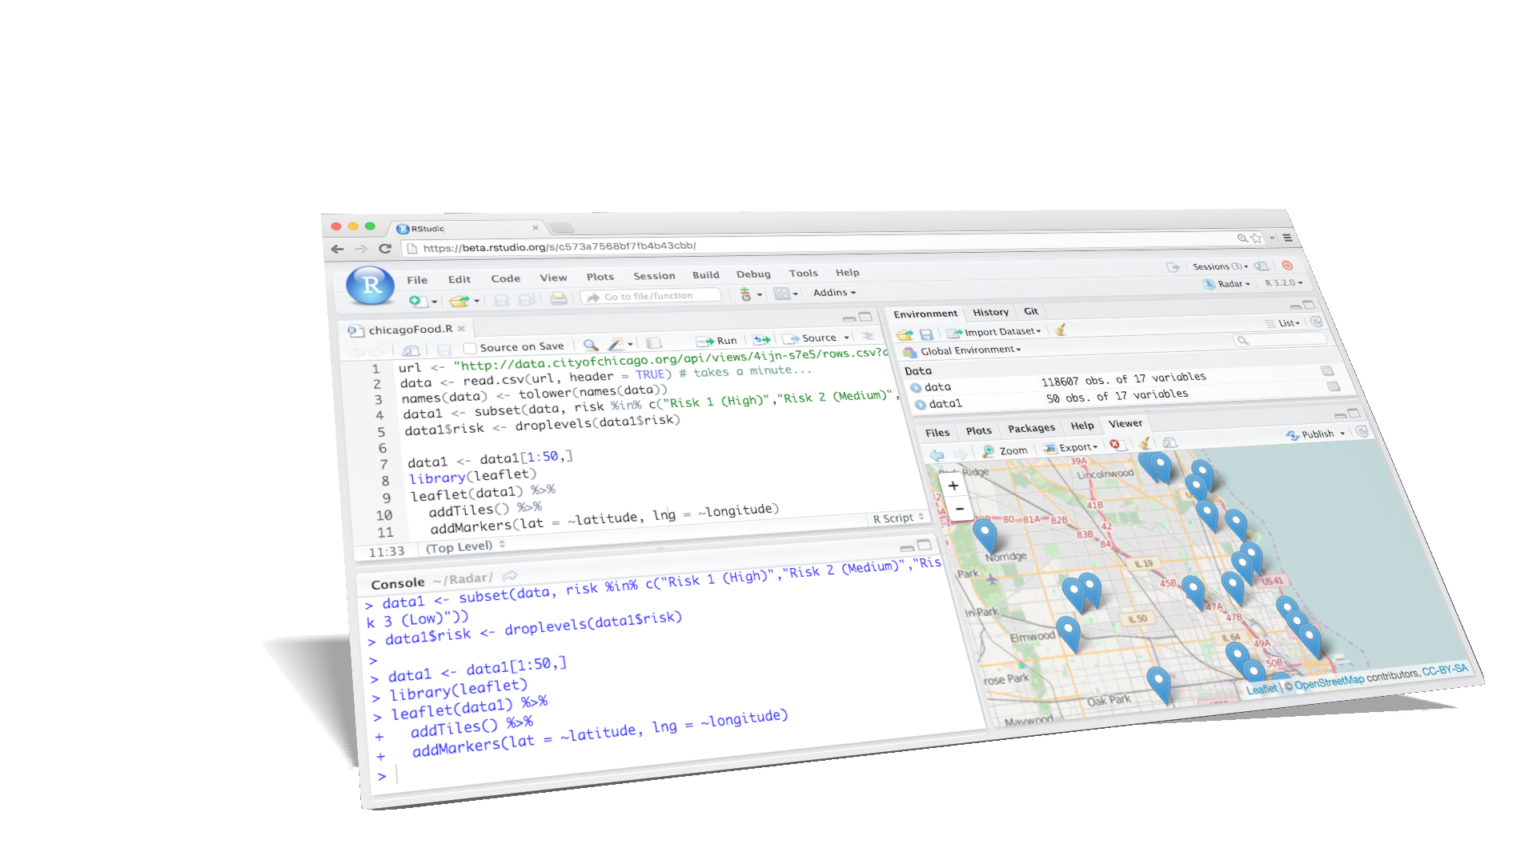
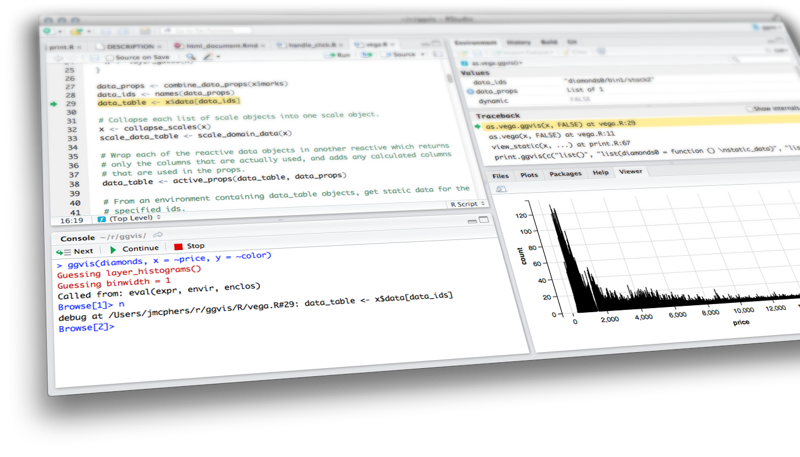

What makes R so special for Data Science?
Joseph Rickert
ODSC West
November 5, 2016

Slide 2
Data Science

Slide 3
A Useful Distinction:
Data Engineering vs Data Science
"The difference between engineers and scientists is that most of the time engineers know what they are doing."
Robert Horton, Data Scientist

Slide 4
Data Engineering
Data Engineering is the discipline of constructing data pipelines.
The analogy with building a physical pipeline works well.
We are talking about putting the hardware in place to extract a raw resource (data) from a storage container (data lake, data base) and refining it by getting it to flow through a transforming processes.
The detailed knowledge required is pretty much fixed by the hardware, the operating systems and the data storage systems.
The emphasis is on building infrastructure.

Slide 5
Data Science
Data Science is discipline of applying the scientific method to solving data intensive problems in science, government, health care and business.
A skeptical, scientific mindset is important.
Most substantial data science projects involve significant data engineering, but the emphasis is on, modeling, inference and prediction.
Source: Microsoft

Slide 6
Data Science Process: Good Day
Question
Collect data
Explore
Model
Make inferences
Report
Hypothesize
This is why statisticians sometimes get confused about being data scientists

Slide 7
Data Science Process: Other Days
Get some huge, messy data
Explore
Figure out the question
Model
Make inferences
Report
Hypothesize
Prepare data
Feature Engineering
Could require some serious Data Engineering
Could require some serious people skills
Could require some serious programming
Could require some serious domain knowledge

Slide 8
THE POSTMODERN READER
“Listen Corso, there are no innocent readers anymore. Each overlays the text with his own perverse view. A reader is the total of all he’s read, in addition to the films and television he’s seen. To the information supplied by the author he’ll always add his own.”
Arturo Perez Reverte: The Club Dumas

Slide 9
THE POSTMODERN
DATA SCIENTIST
The data does not speak for itself!
There are no innocent data scientists
The Rashomon Effect: For large, complex data sets there are often many models, each using different variables, that meet the same performance criteria.
Leo Breiman - Statistical Modeling: The Two Cultures http://www.stat.uchicago.edu/~lekheng/courses/191f09/breiman.pdf

Slide 10
What does a good data science environment look like?
A Data Science Environment should:
Facilitate thinking
Encourage exploration and experimentation
Contain statistical modelling and visualization tools and make it easy to develop custom tools
Provide easy access to other computing tools
Provide easy access to production level data
Facilitate reporting and communication
Integrate well with production pipelines

Slide 11
R

Slide 12
“One of the attractions of R has always been the ability to compute an interesting result quickly.
A key motivation for the original S remains important now: to give easy access to the best computations for understanding data“
John Chambers; Extending R

Slide 13

A Brief History of R
1976: John Chambers and colleagues at Bell Labs begin working on S
1993: Research project in Auckland, NZ
1995: R released as open-source software
1997: R core group formed
2000: R 1.0.0 released
2003: R Foundation formed in Austria
2004: First international user conference
2007: Revolution Analytics founded
2008: RStudio founded
2009: New York Times article on R
2015: The R Consortium Founded
Robert Gentlemen and Ross Ihaka
Photo credit: Robert Gentleman

Slide 14
R is a Functional, Object Based Language
3 Principles for Understanding R, the Language
Everything that exists in R is an object
Everything that happens in R is a function call
Interfaces to other software are part of R
It was always understood that R is meant to build on a base of computational tools. R relies on the ability of functions to communicate with, and exchange objects with other software.
John Chambers, Extending R CRC 2016

Slide 15
R: the big picture
An interactive environment for data analysis
A open source programming language that was designed to be extended by users!!
A platform for data visualization
An interface to other computing resources
An ecosystem around a vibrant community of users and developers

Slide 16
R Centric Data Science
R facilitates “Flow”: that “sense of effortless action”
Mihaly Csikszentmihalyi
Get some huge, messy data
Explore
Figure out the question
Model
Make inferences
Report
Hypothesize
Prepare data
Its all About Flow
R enables quick iterations through this flow.
R designed to optimize
human productivity.

Slide 17
R Ecosystem

Slide 18
R Infrastructure
CRAN
9,000 + tested packages
Network of over 140 mirrors
Bioconductor
1,200 + packages for genomic data
R-Hub
Build system
R Consortium
Established to enhance R infrastructure

Slide 19
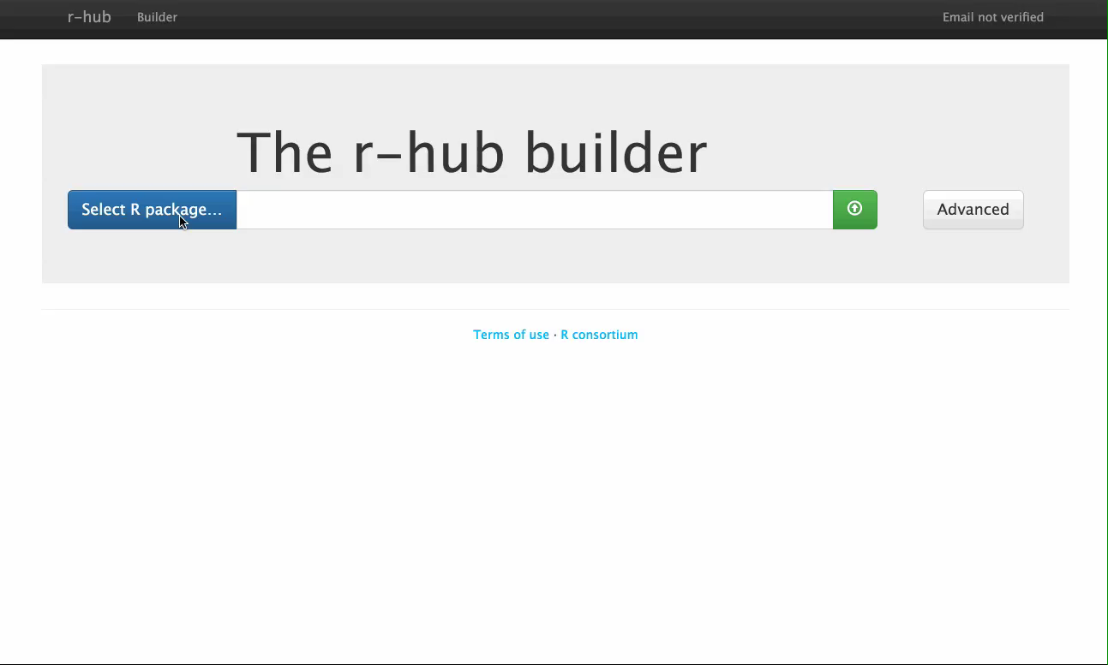

Slide 20
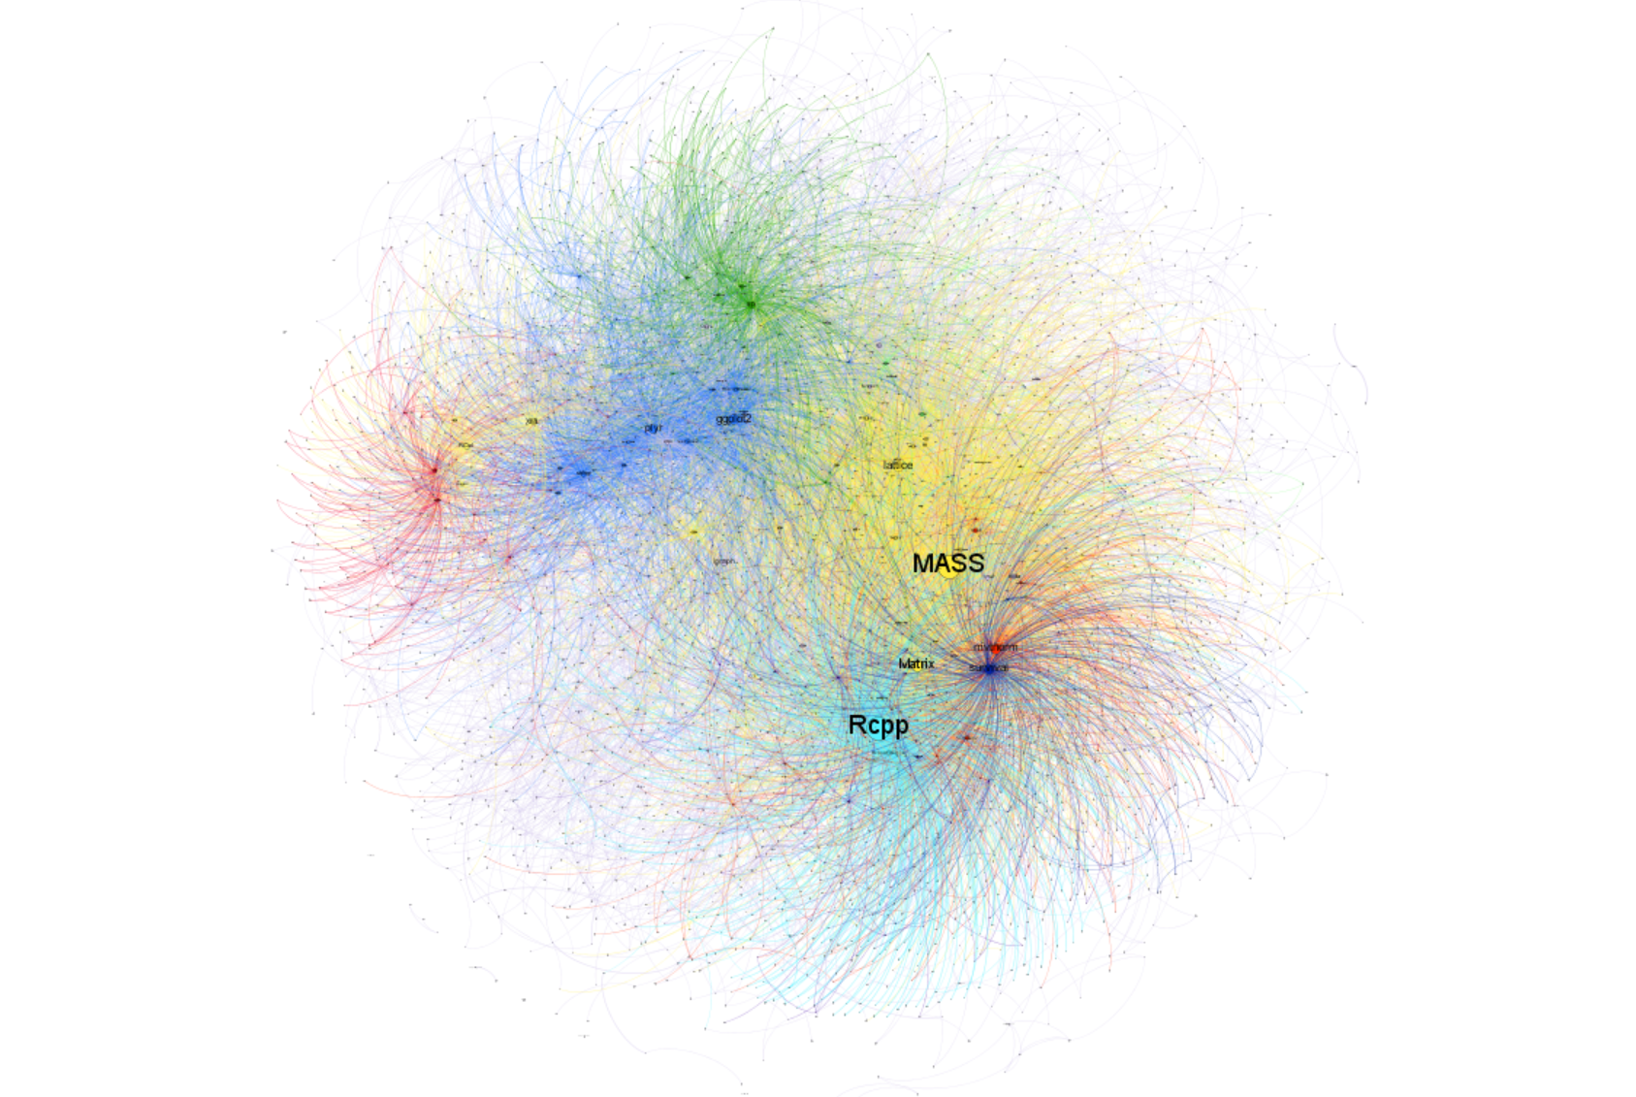
R’s Package System
Is the way that R Grows
Provides
Algorithms
Interfaces to other languages
Interfaces to data platforms
Interfaces to other computing resources
Sharing packages drives the R Community

Slide 21
Some Data Science Packages
tidyverse - data access, wrangling & viz
ggplot2 - data visualization
dplyr - data manipulation
tidyr - data tidying
readr - data import
purrr - functional programming
data.table – fast alt. to data frame for big data
Rcpp - seamless R to C++ for high perf code
caret - for machine learning algorithms
checkpoint - for reproducible research
vtreat - statistically sound data preparation
Machine Learning Task View
Source for Plot

Slide 22
The R Community
R User Groups

Slide 23
DeltRho Project Open Source Project For analyzing big data in R
Divide and Recombine
Trellis Scope Visualizations

Slide 24
rOpenSci
ropensci.org

Slide 25
Who is Doing Data Science with R?
RStudio Customer Spotlights
More Companies using R

Slide 26
Working with R

Slide 27



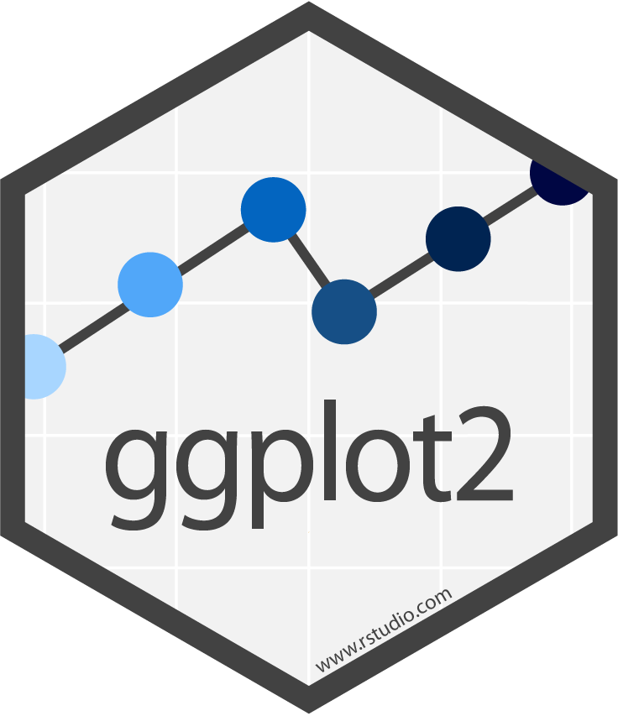

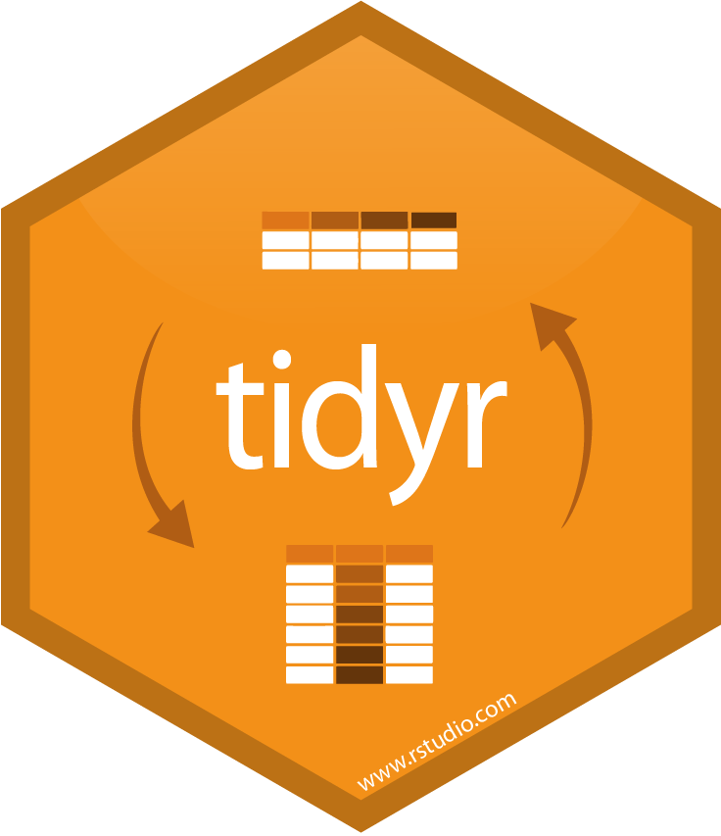





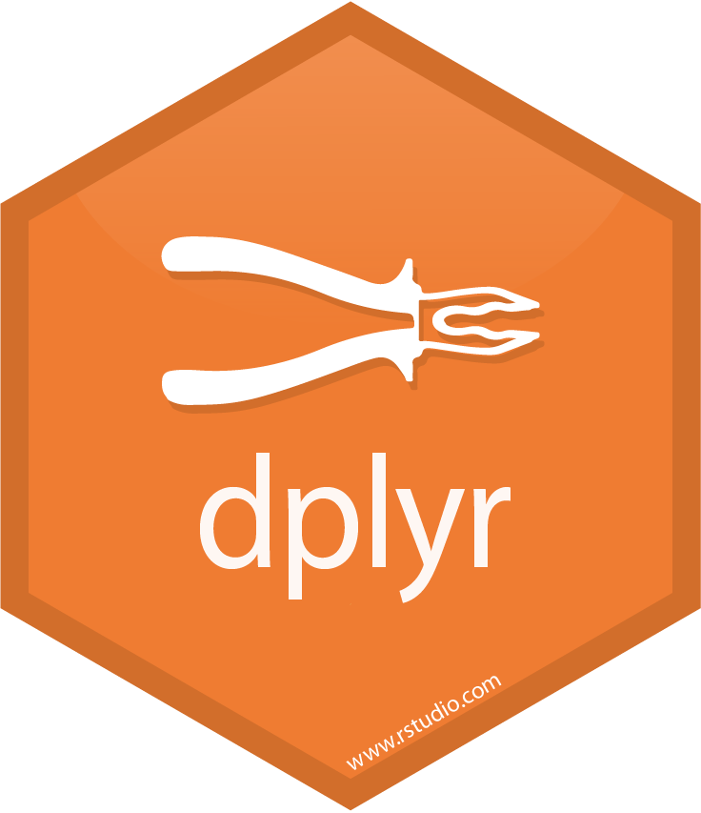
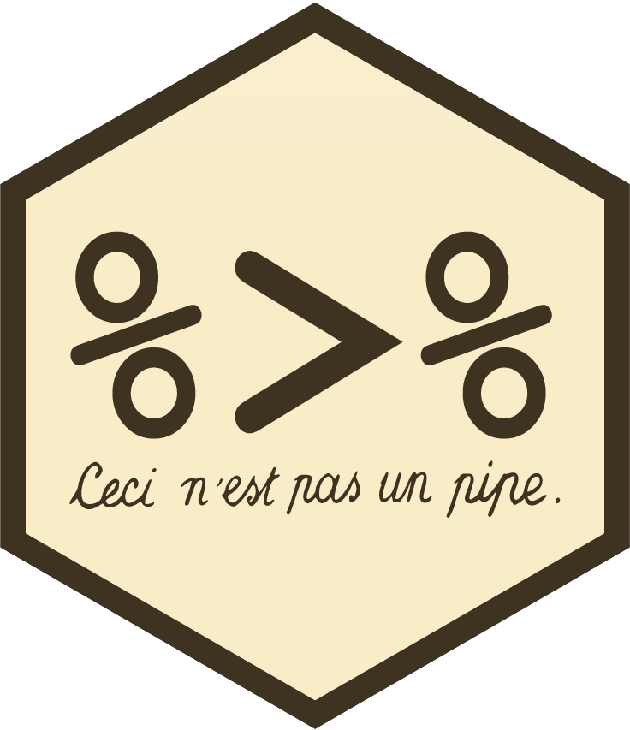
An R Data Science Flow
Import
Visualize
Tidy
Transform
Communicate
Model
Understand
R for Data Science, Grolemund & Wickham

Slide 28
Import
Web Data
Tools for scraping web pages
Tools for parsing structured web data
XML/HTML
JSON
Tools for working with HTTP Requests
Connect to big data platforms
Spark / Hadoop
H2O
Connecting to databases
SQLite
PostgressSQL
MySQL / MariaDB
BigQuery
Microsoft SQL Server
HP Vertica
Oracle
There are open source connectors to almost anything.
Additionally, DB vendors offer high performance R access

Slide 29









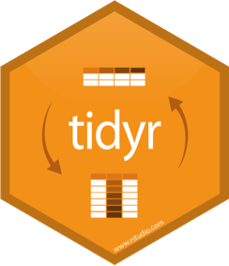
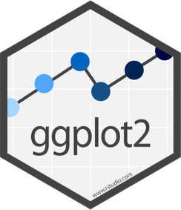













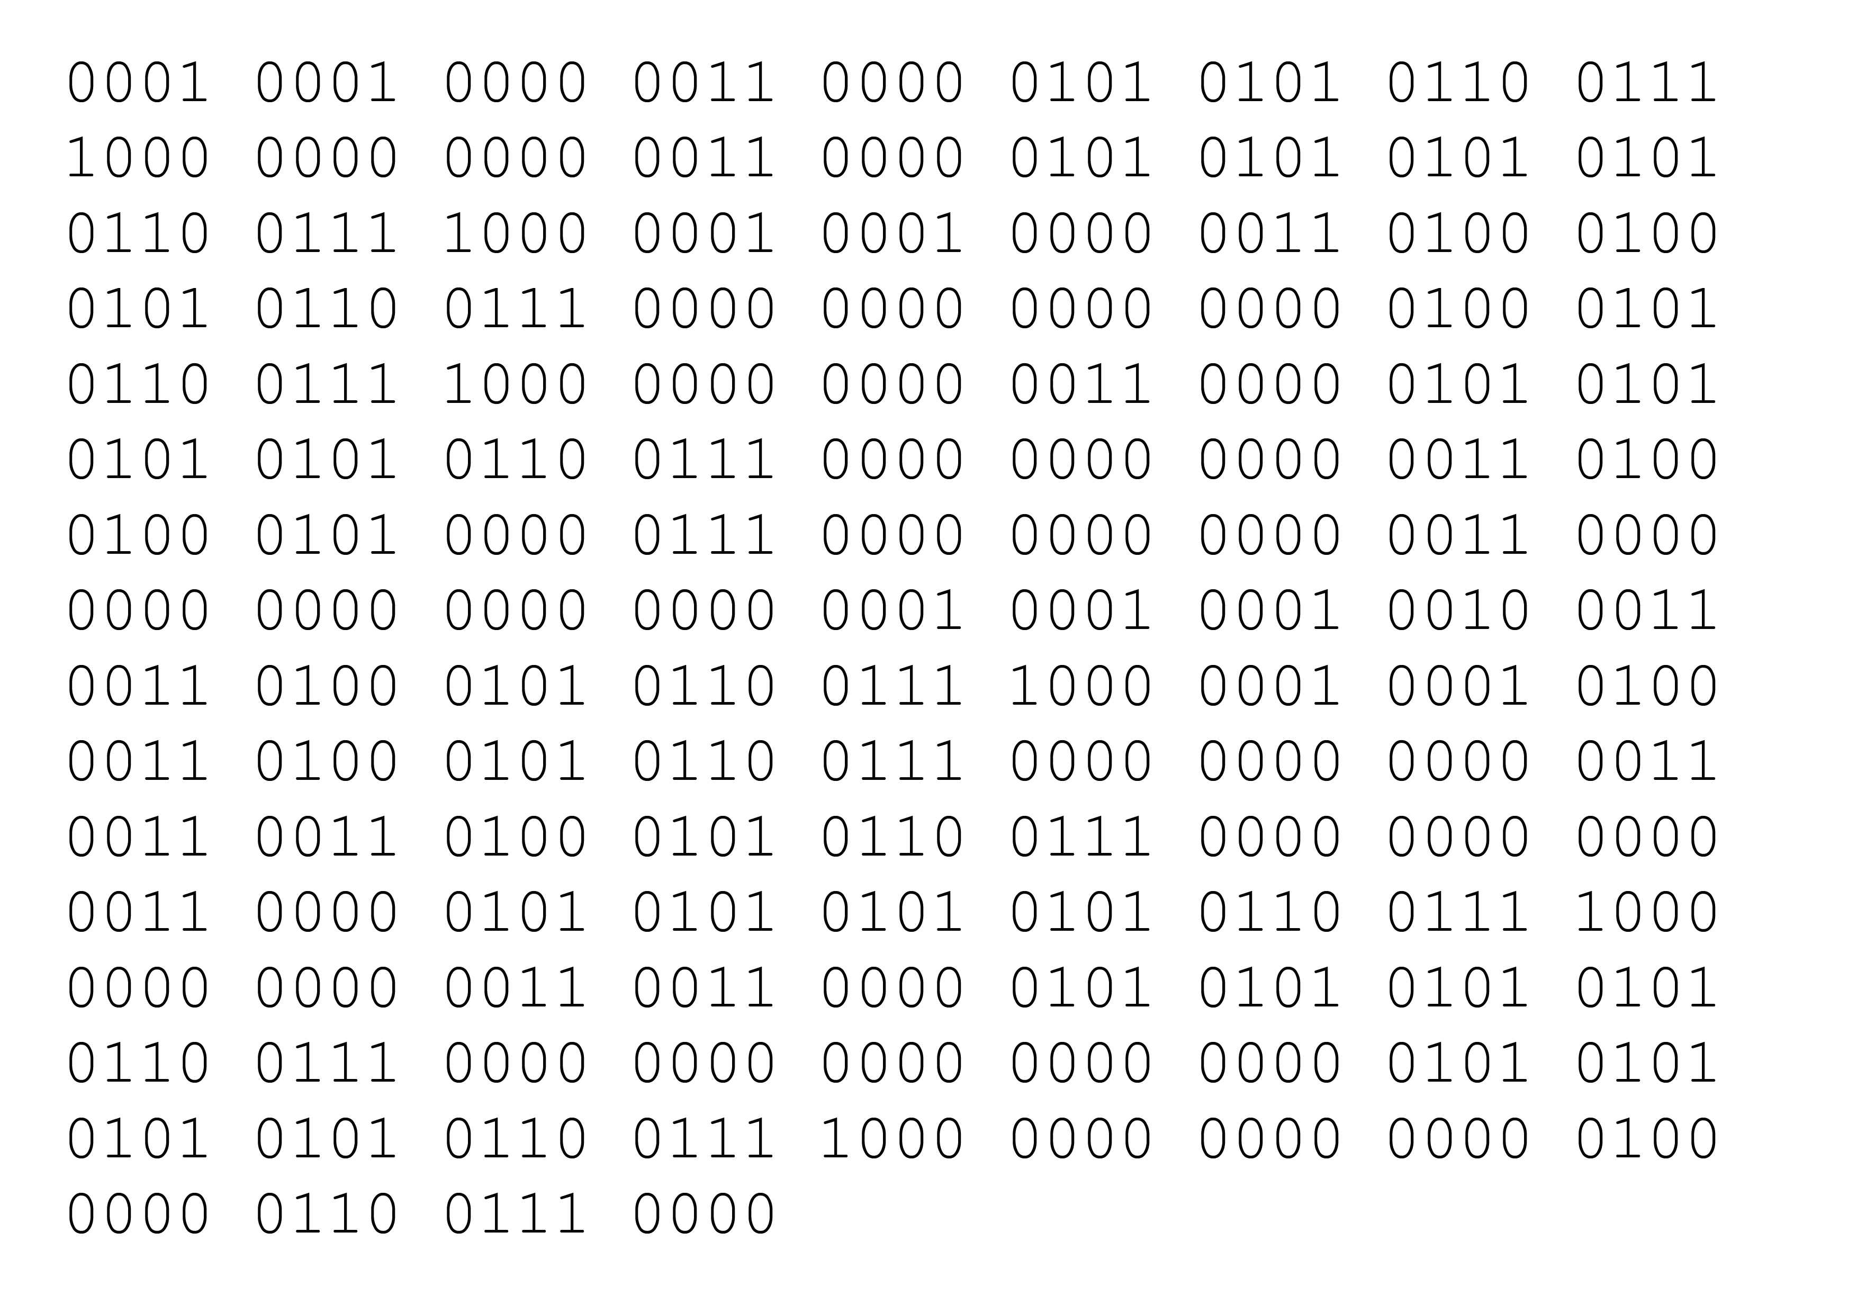

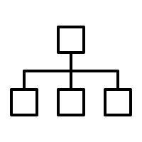

R on Spark
Analytic Understanding - Developers
Analytic Communication – End users
RStudio
Server
(Cluster)
RStudio Connect
Shiny Server
shinyapps.io
Apps
Docs
Plots
Analytic Engine
CRAN, MRO, R Enterprise, etc.
Compiled or binaries
R Packages
Flat
Files
Data
Warehouse
Apache Spark
Hadoop
Data Sources

Slide 30
Exploration
Statistics, plots, models, interactive visualizations

Slide 31
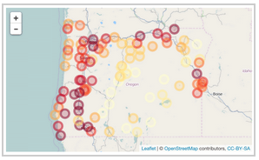
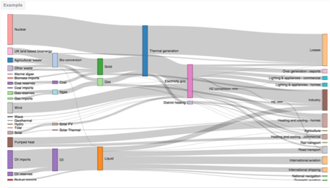
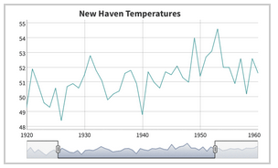
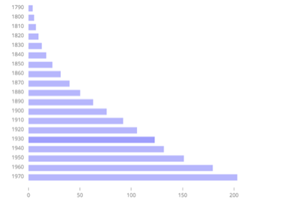
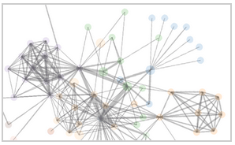
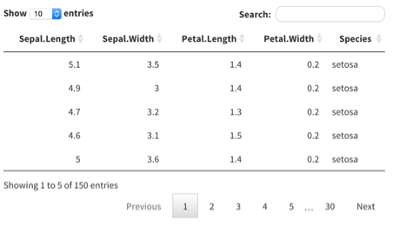
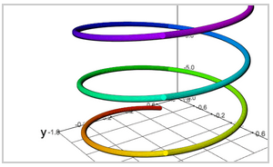
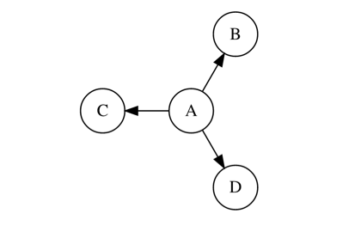
Javascript Visualizations
Packages with ready-to-use htmlwidgets:
Leaflet - Interactive maps
rstudio.github.io/leaflet/
rCharts - Various charts
rCharts.io
dygraphs - Time series
rstudio.github.io/dygraphs
MetricsGraphics - d3 charts
hrbrmstr.github.io/metricsgraphics/
networkD3 - network graphs
christophergandrud.github.io/networkD3/
DT - Data tables
rstudio.github.io/DT/
threejs - 3D charts
github.com/bwlewis/rthreejs
Diagrammer - Diagrams
rich-iannone.github.io/DiagrammeR/

Slide 32
Modeling
e.g. glm()
glm() function part of base R
Packages to help with convergence and improve the fit
glm2 implements a refinement to the IRLS algorithm in order to help with convergence issues commonly associated with nonstandard link functions.
brglm fits binomial response models with a bias reduction method
safeBinaryRegression provides a function that overloads glm() to provide a test for the existence of the maximum likelihood estimates for binomial models
pscl provides goodness of fit measures for GLMs
Packages for variable selection and regularization
bestglm selects a “best” subset of input variables for GLMs using cross validation and various information criteria.
glmnet provides functions to fit linear regression, binary logistic regression and multinomial normal regression with convex penalties.
penalized fits high dimensional logistic and poisson models with L1 and L2 penalties
Packages for special models
mlogit fits multinomial logit models.
lme4 provides functions to fit mixed-effect GLMS
hglm fits hierarchical GLMs with both fixed and random effects
glmmML provides functions to fit binomial and poisson models with clustering.
Bayesian GLMs
arm provides functions for Bayesian GLMs (Look here for a discussion of how Bayesian ideas can help with GLM problems.)
bayesm contains functions for Bayesian GLMs including binary and ordinal probit, multinomial logit, multinomial probit models and more
MCMCglmm provides functions to fit mixed GLMs using MCMC techniques
GLMs for Big Data
The bigglm() function in the biglm package fits GLMs that are too big to fit into memory.
H20 package from 0xdata provides an R wrapper for the h2o.glm function for fitting GLMs on Hadoop and other platforms
speedglm fits GLMs to large data sets using an updating procedure.
RrevoScaleR (Microsoft) provides parallel external memory algorithms for fitting GLMs on clusters
Generalized Additive Models, GAMS,generalize GLMs
gam provides functions to fit the Generalized Additive Model
gamm4 fits mixed GAMs.
mgcv provides functions to fit GAMs with muttiple smoothing methods.
VGAM provides functions to fit vector GLMs and GAMs.
R has the most sophisticated and complete library of statistical algorithms
Bayesian Stats
Machine Learning
Multivariate Stats
Spatial Stats
Time Series
etc.
Source: revolutions blog

Slide 33

Reporting
Rmarkdown
R Markdown documents are fully reproducible. Use a productive notebook interface to weave together narrative text and code to produce elegantly formatted output. Use multiple languages including R, Python, and SQL.

Slide 34
Multi-Language Notebooks
An R Notebook is an R Markdown document with chunks that can be executed independently and interactively, with output visible immediately beneath the input
RStudio
Jupyter

Slide 35
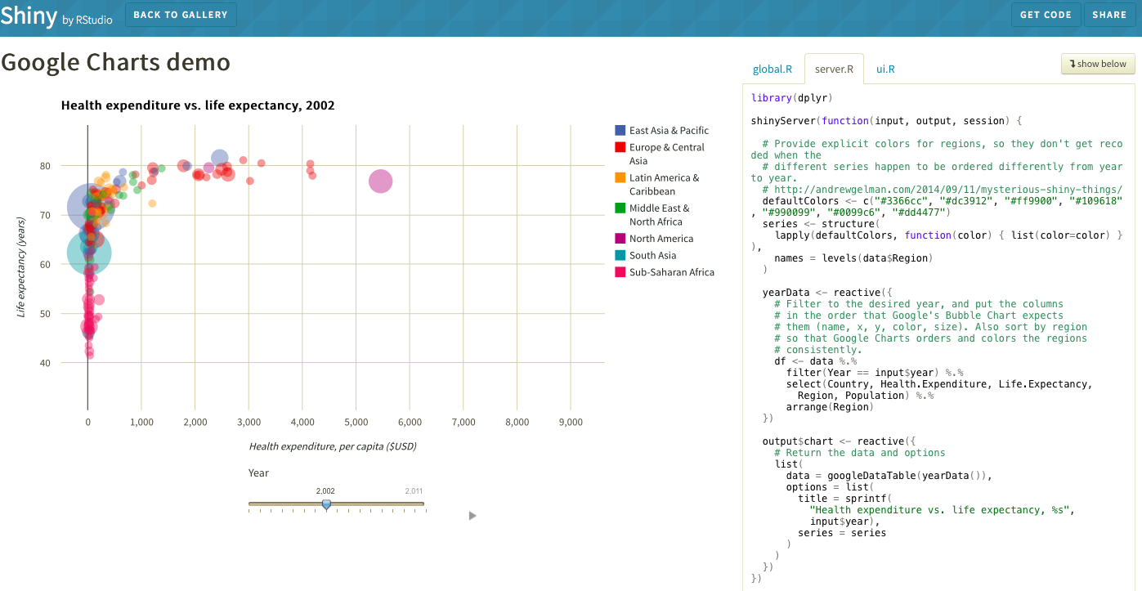
Sharing
Shiny Gallery

Slide 36
R: the Best Choice for Data Science
R was designed to be an interface to the best things computing has to offer.
The functional, object oriented design of R is well suited for statistical modeling.
R interfaces exist for Spark / Hadoop and other big data platforms.
R has the most complete library of statistical modeling algorithms.
The R Community continues to expand R’s capabilities.
The R Consortium is expanding R’s infrastructure while providing a forum for companies dedicated to bringing R to the enterprise.

Slide 37

Open Source & Free
Desktop: http://www.rstudio.com/products/rstudio/download/
RStudio Server: http://www.rstudio.com/products/rstudio/download-server/
Shiny Server: http://www.rstudio.com/products/shiny/download-server/
shinyapps.io beta: https://www.shinyapps.io/admin/#/signup
45 Day Evaluation of Pro Products
RStudio Server Pro: http://www.rstudio.com/products/rstudio-server-pro/evaluation/
Shiny Server Pro: http://www.rstudio.com/products/shiny-server-pro/evaluation/

